Slide 1
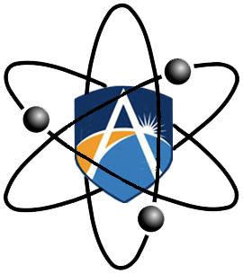
Excretory System

Slide 2
Excretion
Excretion: Removal of waste of metabolism from the body
By-products are often toxic
Need to be removed before reaching dangerous concentrations
Notes:
Metabolism: all the chemical reactions occurring in the body
By-products of metabolism are toxic

Slide 3
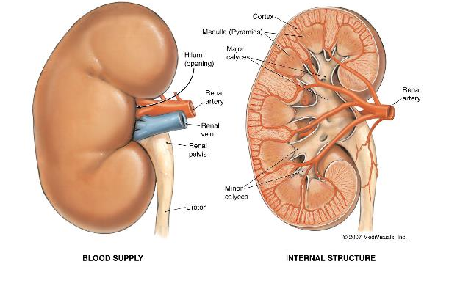
Kidneys
Pair of red-brown organs
Each is 11cm long
Kidneys, bladder and associated ducts = urinary/excretory system

Slide 4
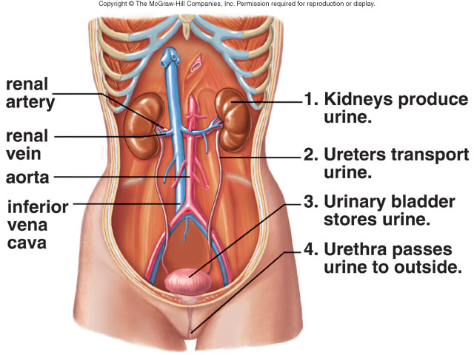
Kidneys

Slide 5
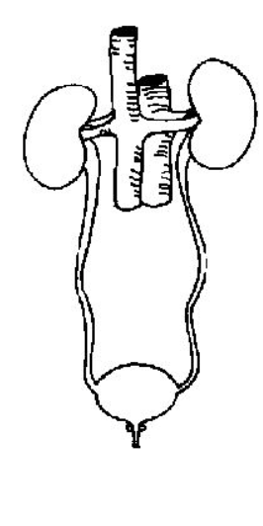
Kidneys

Slide 6
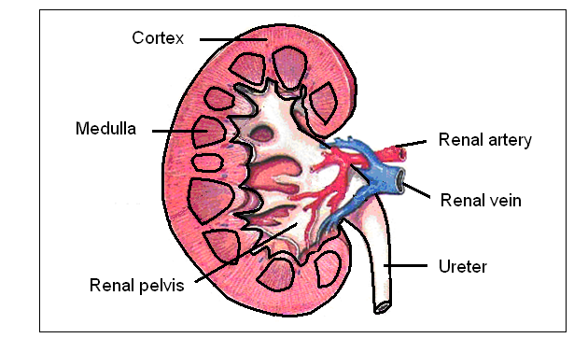

Slide 7
Functions of the kidneys
Removing wastes from the blood e.g. nitrogenous wastes such as urea, uric acid & creatinine
2. Regulating blood composition e.g. fluid level, salt concentration and pH level.

Slide 8
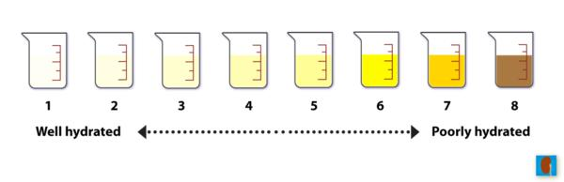
Urine Composition
Regardless of water availability a minimum of ~0.5L/day of water is required for this
Typically ~1.5L/day of urine produced

Slide 9
Urine Composition
In a healthy individual urine contains no protein or glucose
Main components:
Water
Urea
Uric acid: produced from metabolism of purines
Creatinine: Produced in muscle from creatinine phosphate
Ions
Notes:
Purines: adenine & guanine and can come from many foods

Slide 10
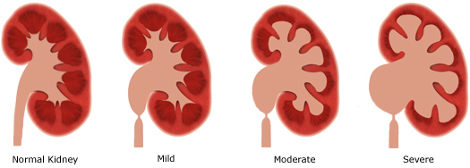
Maintaining healthy kidneys
Lifestyle measures:
Healthy diet
Healthy weight
No smoking
Drink water
Alcohol in moderation
No performance-enhancing drugs

Slide 11
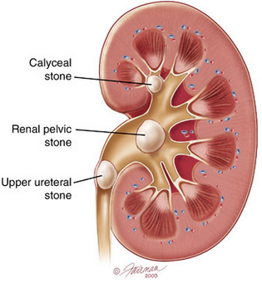
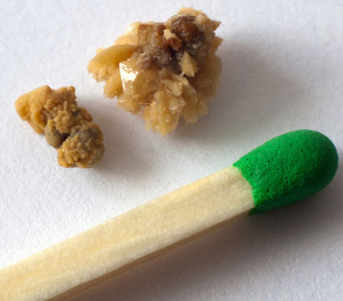
Kidney Stones
Form when urine is too concentrated
Solid crystals get stuck in kidneys, ureter, bladder or urethra

Slide 12
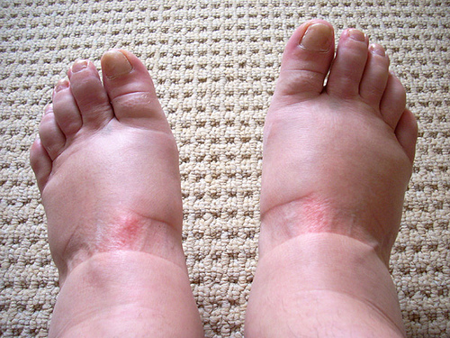
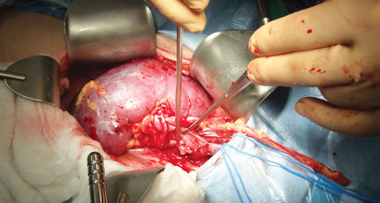
Kidney Failure
Loss of kidneys ability to excrete waste & control fluid levels in body
Glomeruli unable to filter properly
trauma, genetics, lifestyle are all causes
Symptom is protein & RBC’s present in urine
Leads to oedema (swelling) of face, hands & feet
Eventually dialysis or kidney transplant required

Slide 13

Dialysis
Dialysis: method of removing wastes from blood during kidney failure
Haemodialysis (artificial kidney)
Blood filtered out of the body
Pumped through a tube with many membranes
Wastes are diffused out 3 times/week

